Slide 1




VIDYUT SYSTEMS BIOLOGY WORKSHOP – May 2025
LEAF:A Federated Learning-Aware Privacy Preserving Framework for Healthcare Ecosystem
ANUJA KUNJUMON
AM.SC.R4CSE23022
Amrita School of Computing
Amritapuri Campus
from memory to movement: exploring THE common grounds in ad & pd

Slide 2

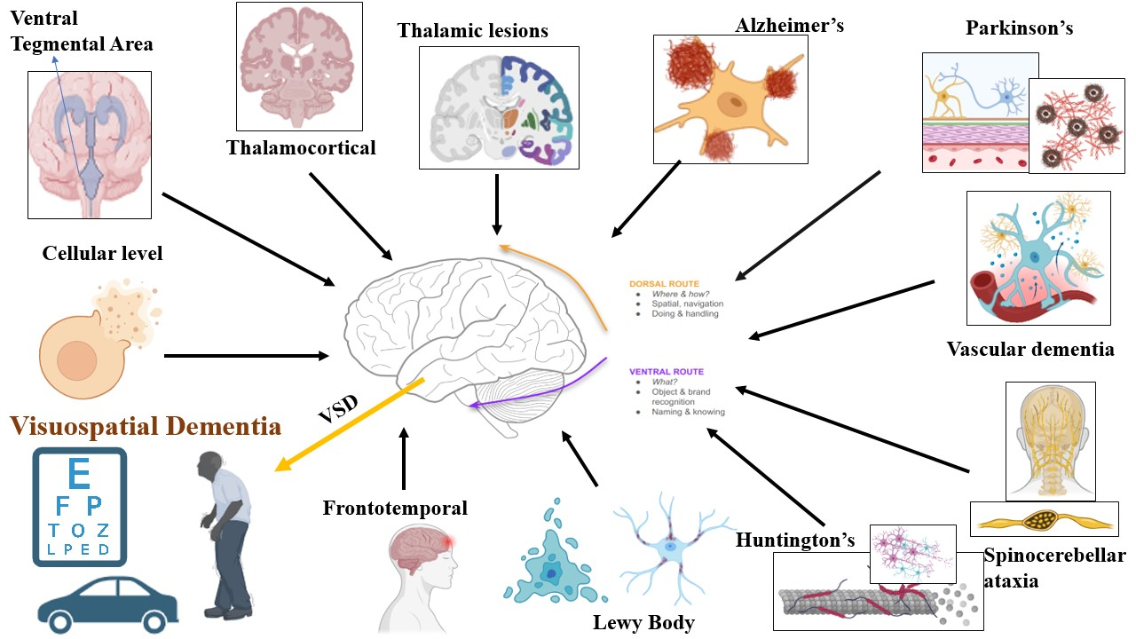
Overview of ND’S
2
References
Fukui, T., & Lee, E. (2009). Visuospatial function is a significant contributor to functional status in patients with Alzheimer’s disease. American Journal of Alzheimer’s Disease and Other Dementias, 24(4), 313–321. https://doi.org/10.1177/1533317509333903
Johnson, D. K., Morris, J. C., & Galvin, J. E. (2005). Verbal and visuospatial deficits in dementia with Lewy bodies. Neurology, 65(8), 1232–1238. https://doi.org/10.1212/01.wnl.0000180964.60708.c2
Mohr, E., Claus, J. J., & Brouwers, P. (1997). Basal ganglia disease and visuospatial cognition: Are there disease-specific impairments? Behavioural Neurology, 10(2–3), 67–75. https://doi.org/10.1155/1997/428549

Slide 3
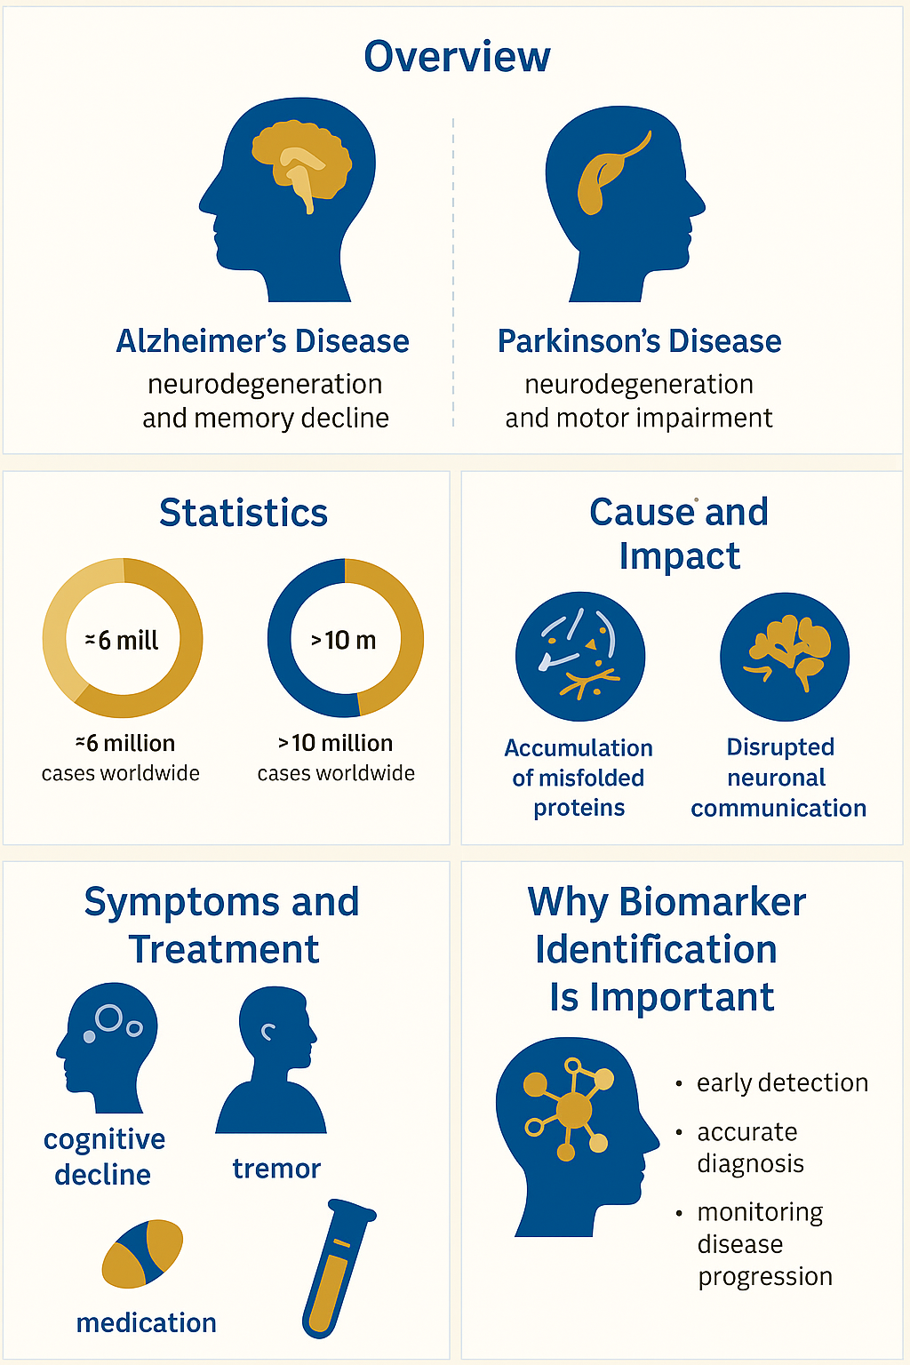
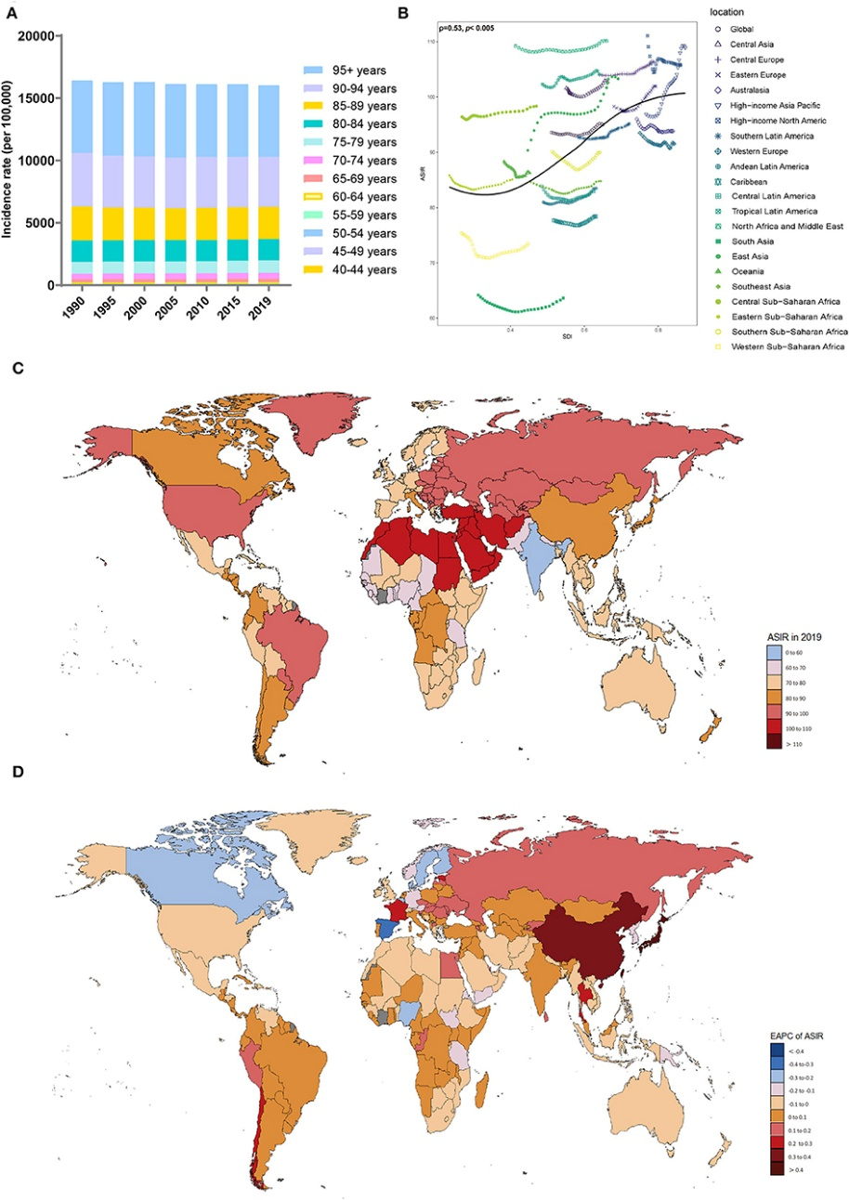
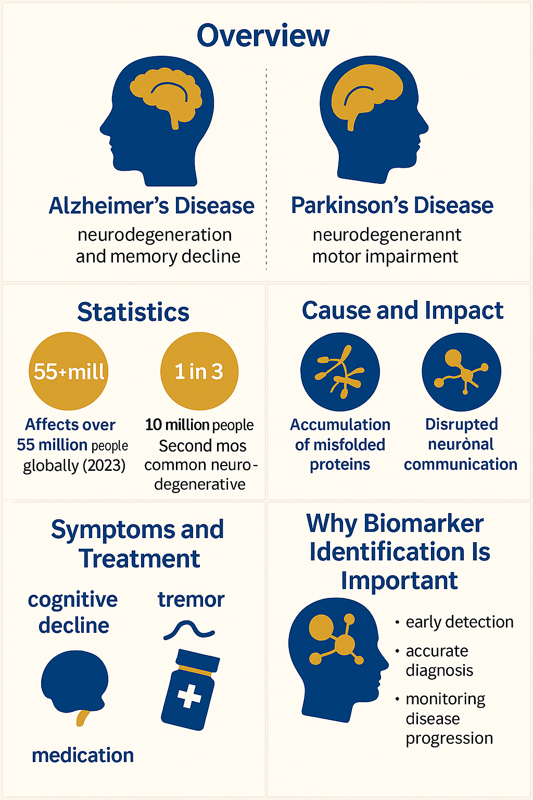
AD & PD
References
7) Chen, Q., Xia, S., Sui, H., Shi, X., Huang, B., & Wang, T. (2022). Identification of hub genes associated with COVID-19 and idiopathic pulmonary fibrosis by integrated bioinformatics analysis. PLoS ONE, 17(1 January), 1–17. https://doi.org/10.1371/journal.pone.0262737
8) Chin, C. H., Chen, S. H., Wu, H. H., Ho, C. W., Ko, M. T., & Lin, C. Y. (2014). cytoHubba: Identifying hub objects and sub-networks from complex interactome. BMC Systems Biology, 8(4), S11. https://doi.org/10.1186/1752-0509-8-S4-S11

Slide 4
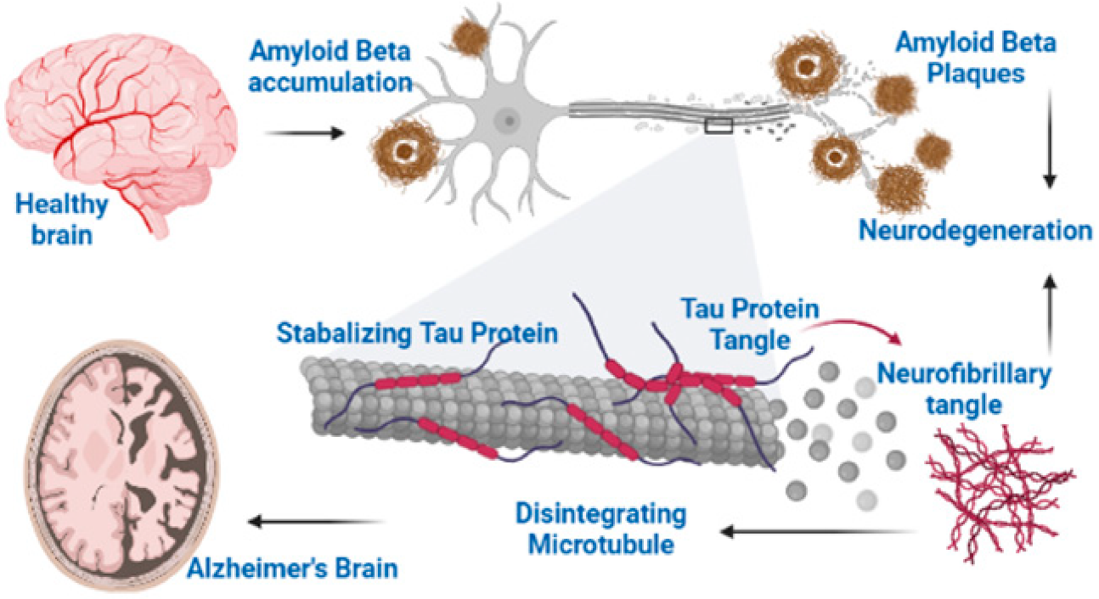
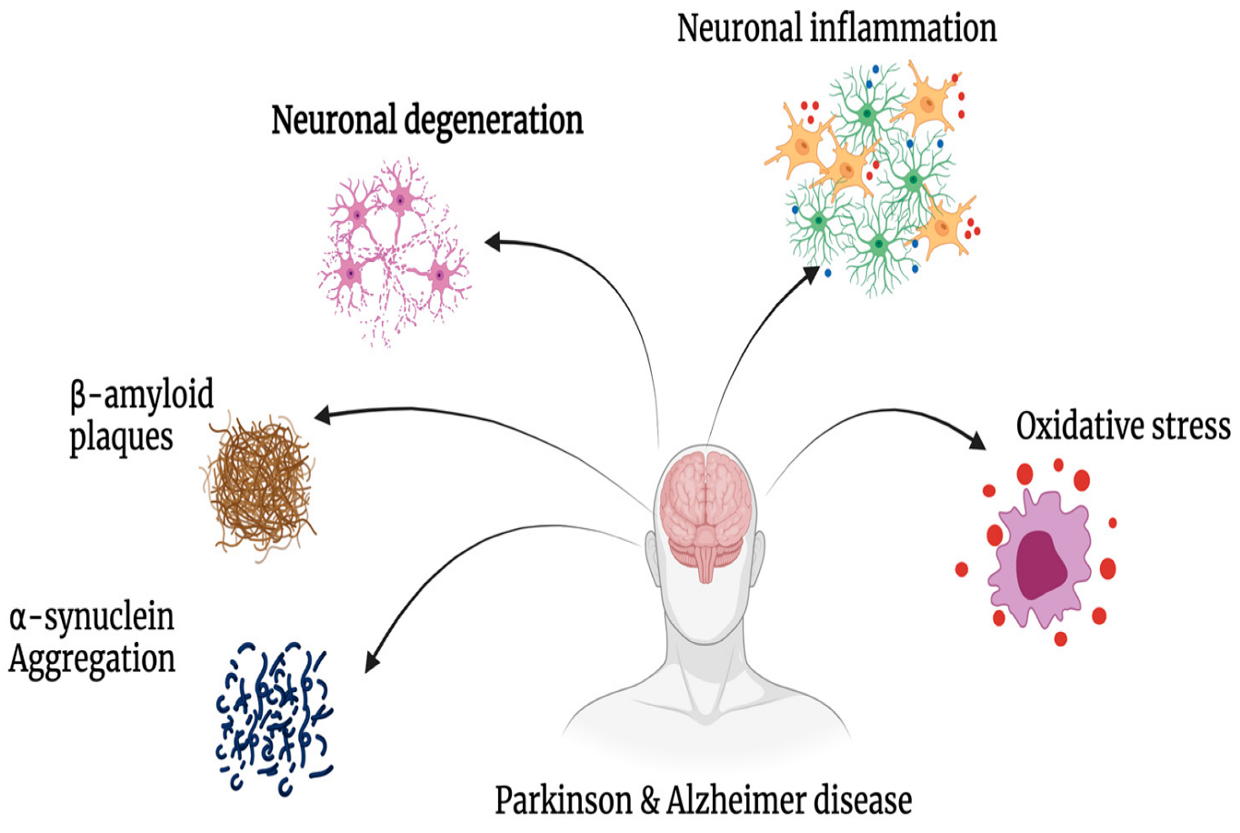
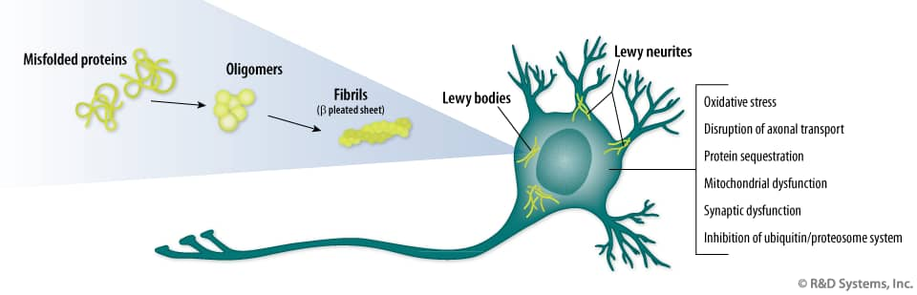
How AD & PD occurs?

Slide 5
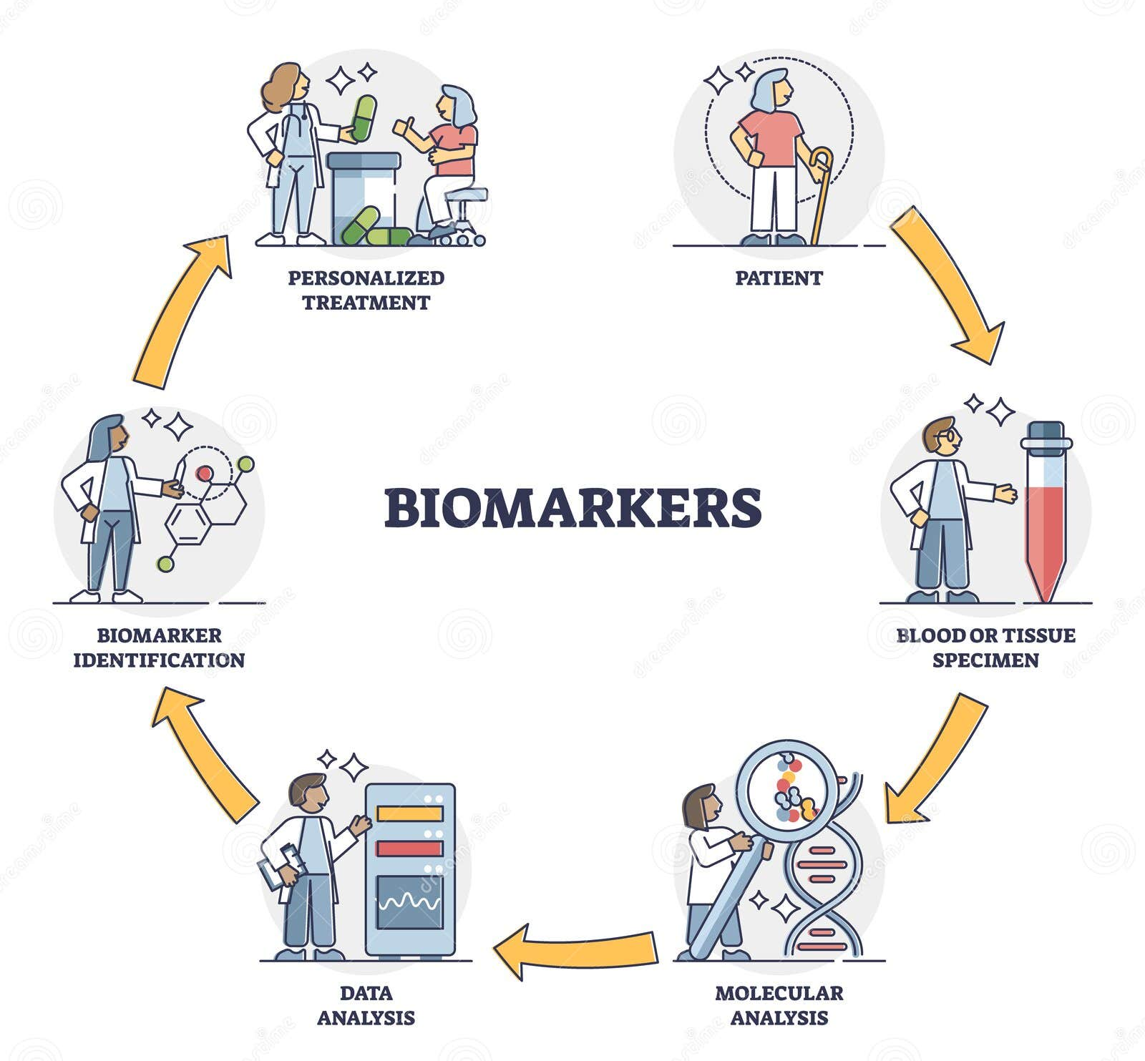
Distinguish between different dementia types (e.g., VSD vs. AD vs. FTD)
Tracking disease stage
Current therapeutics includes for Alzheimer’s and other dementia related drugs (e.g., donepezil, rivastigmine and galantamine; memantine, L-dopa, carbidopa)

Slide 6






Today’s workshop
Write the PMID
Study highlights
Key factors involved/ identified
Methodology used
Observance
Build a system model using the obtained factors

Slide 7

THANK YOU

